Slide 1

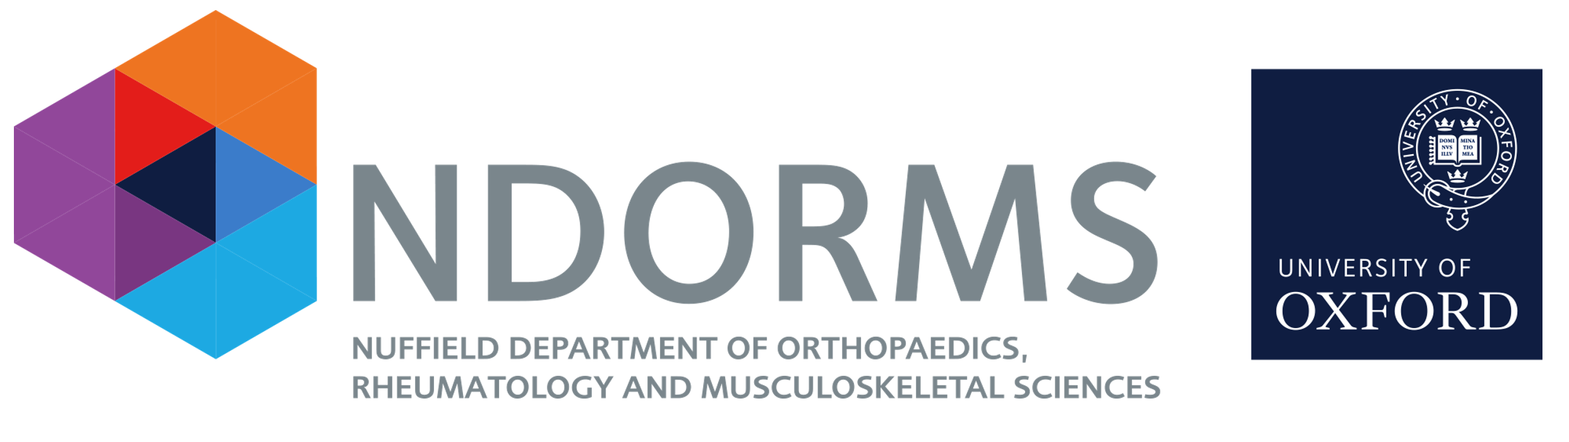
PDE group Internal training
Martí Català
Edward Burn
31 Oct – 3 Nov 2022

Slide 2
Getting started with R (31 Oct)

Slide 3
Writing bespoke code for the OMOP CDM (1 Nov)
Theory:
How to connect to the database (DBI)
A friendly way to connect to OHDSI database (CDMConnector)
Mock database (Eunomia)
Working with data bases in R (dplyr & dbplyr)
Practicum:
Part 0 Understand Commands
Part 1 Basic Commands
Part 2 Build a cohort

Slide 4
Running OHDSI code for the OMOP CDM (2 Nov)
Theory:
Create a concept set (CodelistGenerator)
Instantiate the cohorts in the database (CohortGenerator)
Evaluate our cohort (CohortDiagnostics)
Compute the incidence and prevalence (IncidencePrevalence)
Share a project and make sure they can execute (renv)
Practicum:
Part 0 Execute the example
Part 1 Install all packages
Part 2 Make your own network study

Slide 5
Making R packages (3 Nov)

Slide 6

Suggested formations
The book of OHDSI (https://ohdsi.github.io/TheBookOfOhdsi/)
EHDEN academy (https://academy.ehden.eu/):
OMOP CDM and Standardised Vocabularies
ATLAS
Phenotype Definition, Characterisation and Evaluation
Data camp:
Introduction to R, Intermediate R, Introduction to the Tidyverse, Working with Data in the Tidyverse, Data Manipulation with dplyr, Joining Data with dplyr, Introduction to Data Visualization with ggplot2
*
* Darwin is paying for it. If you need it send us a mail or ping us on teams

